Slide 1
Indian Knowledge System (IKS)
A Holistic Legacy of Tradition, Innovation, and Integration
Dr. Manjulata Sao (Asst. Professor, Commerce)
Govt. Dr. W.W. Patankar Girls’ PG College, Durg (C.G.)

Slide 2
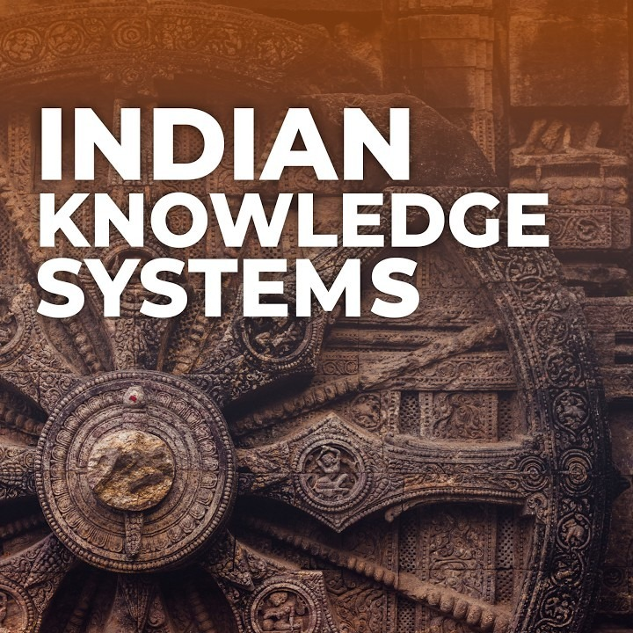

Slide 3
Introduction
Comprehensive body of knowledge across science, philosophy, medicine, arts, and more
Holistic approach combining spiritual, ethical, experiential, and empirical insights

Slide 4
Historical Foundations
Core texts: Vedas, Upanishads, Puranas
Transmission through oral traditions: Śravaṇa, Manana, Nididhyāsana
Guru–Shishya parampara for personalized learning

Slide 5


Slide 6
Philosophies and Epistemology
Vedanta, Nyāya, Sāṃkhya schools
Nyāya: Four pramāṇas – perception, inference, comparison, testimony
Sāṃkhya: Three pramāṇas – perception, inference, testimony

Slide 7
Scientific & Mathematical Contributions
Mathematics: Zero, decimal system, algebra, geometry
Astronomy: Aryabhaṭa, Varāhamihira, Bhāskara II
Metallurgy: Iron Pillar of Delhi

Slide 8
Medicine, Health & Well‑being
Ayurveda: Dosha balance, herbal remedies, Panchakarma
Yoga & Meditation for physical, mental, and spiritual wellness

Slide 9
Arts, Language & Culture
Dance, music, crafts preserving moral and cultural values
Linguistics: Panini’s grammar, Nyāya logic

Slide 10
Architecture & Ecological Wisdom
Vastu Shastra principles for harmonious living
Sustainable agriculture and water systems like Johad

Slide 11
Knowledge Preservation & Modern Revival
IKS Division under MoE/AICTE for interdisciplinary research
Traditional Knowledge Digital Library (TKDL)
Educational initiatives in IKS

Slide 12
Contemporary Relevance
Decolonizing knowledge frameworks
Sustainability through traditional practices
Global acceptance of Ayurveda and yoga

Slide 13
Challenges & Way Forward
Need for systematic documentation
Bridging validation gap in modern science
Stronger institutional support and curriculum integration

Slide 14
Conclusion
IKS offers integrated, ethical, and sustainable living frameworks
Incorporation into education, research, and policy is essential

